Slide 1
Employee Data Analysis using Excel
STUDENT NAME: SUMITHA L
REGISTER NO:122204065
DEPARTMENT:BCOM CORPORATE SECRETARYSHIP
COLLEGE SHRI KRISHNASWAMY COLLEGE FOR WOMEN

Slide 2
PROJECT TITLE
Employee Gender Analysis using Excel

Slide 3


AGENDA
Problem Statement
Project Overview
End Users
Our Solution and Proposition
Dataset Description
Modelling Approach
Results and Discussion
Conclusion
3/21/2024 Annual Review

Slide 4

Problem statement This problem statement clearly articulates the issue, its potential consequences, and invites exploration of solutions to address the disparities and promote gender equity and inclusion.

Slide 5

PROJECT OVERVIEW “Our organization seeks to promote diversity, equity, and inclusion in the workplace. However, we lack a clear understanding of our current gender dynamics. We need to analyze our employee data to identify trends, disparities, and areas for improvement in terms of gender representation, pay equity, career advancement, and workplace experiences. .
.

Slide 6

WHO ARE THE END USERS? 1. *HR Leaders*: To inform diversity, equity, and inclusion strategies, talent management, and policy development. 2. *Diversity, Equity, and Inclusion (DEI) Teams*: To identify areas for improvement, track progress, and develop targeted initiatives. 3. *Business Leaders*: To understand the impact of gender dynamics on business outcomes, such as talent retention, engagement, and innovation. 4. *Managers*: To recognize and address potential biases, improve team dynamics, and support inclusive decision-making.

Slide 7
OUR SOLUTION AND ITS VALUE PROPOSITION A comprehensive analytics solution that provides actionable insights on employee gender dynamics, empowering organizations to promote diversity, equity, and inclusion. 1. *Data-Driven Decision Making*: Unlock the power of data to inform diversity, equity 2. *Identify Areas for Improvement*: Pinpoint disparities in gender. Representation 3. *Inclusive Culture*: Foster a more inclusive workplace culture by addressing biases. 4. *Talent Retention and Attraction*: Enhance talent retention and attraction by promoting gender equity.

Slide 8
Dataset Description _Description:_ This dataset contains aggregated and anonymized data on employee gender dynamics, focusing on: 1. _Demographic Information:_ - Employee ID (anonymized) - Gender (male, female) - Age - Department 2. _Workplace Experience:_ - Job Satisfaction - Engagement - Sense of Belonging 3. _Career Advancement:_ - Promotions - Career Path - Leadership Roles

Slide 9
THE "WOW" IN OUR SOLUTION - Develop targeted initiatives to drive gender equity and inclusion - Enhance employee engagement, retention, and productivity - Unlock the full potential of their workforce, leading to increased innovation, collaboration, and business successInteractive dashboards and visualizations to facilitate easy analysis and storytelling - AI-driven predictive analytics to identify potential gender disparities and recommend proactive solutions - Customizable recommendations for initiatives, policies, and practices to promote gender equity and inclusion
3/21/2024 Annual Review
9

Slide 10
MODELLING
1. Identify gender disparities in hiring, promotion, and pay practices. 2. Predict potential gender disparities in future hiring and promotion decisions. 3. Recommend initiatives, policies, and practices to promote gender equity and inclusion. *Modeling Components:* 1. Gender disparity metrics (e.g., pay equity ratios, promotion rates). 2. Predictive scores for potential gender disparities. 3. Recommended initiatives, policies, and practices to promote gender equity and inclusion. 4. Simulation results evaluating the impact of different initiatives and polices. 1. Data-driven insights to inform diversity, equity, and inclusion strategies. 2. Identification of potential gender disparities before they occur. 3. Evidence-based recommendations to promote gender equity and inclusion. 4. Evaluation of initiative effectiveness and ROI.
10

Slide 11
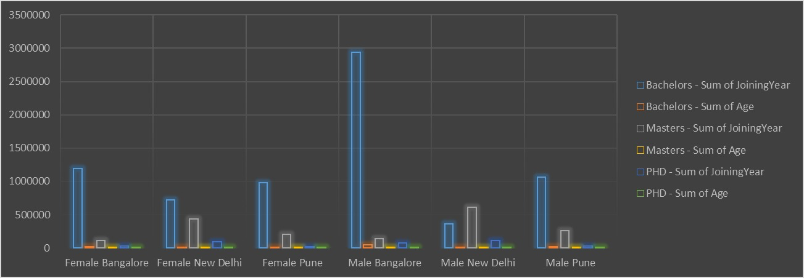
RESULTS
11

Slide 12
Conclusion _Conclusion:_ Our Employee Gender Analysis reveals valuable insights into gender disparities within our organization. By identifying areas of disparity and predicting potential future disparities, we can take proactive steps to promote gender equity and inclusion.

